Slide 1
GIT AND GITHUB
Version control with Git
Credit to RUTH Anderson – Washington DC UNIVERSITY AND GIT HUB-
UPDATED BY AHMAD MOHSIN

Slide 2
Basic Intro to Git
We will:
  Discuss how Git differs from Subversion
  Discuss the basic Git model
  Pull/clone files from a repository on github
  Edit files in your own local Git repo
  Push files to a repo on github

Slide 3

WHY CONTROL VERSIONING?

Slide 4
WHAT YOU DO WHEN YOU CODE?
WRITE CODE
EDIT CODE
SAVE CODE
SAVE CODE AGAIN
……
CHANGES .. .. CHANGES….. …. .OHHHH… HOW TO MANAGE ?

Slide 5
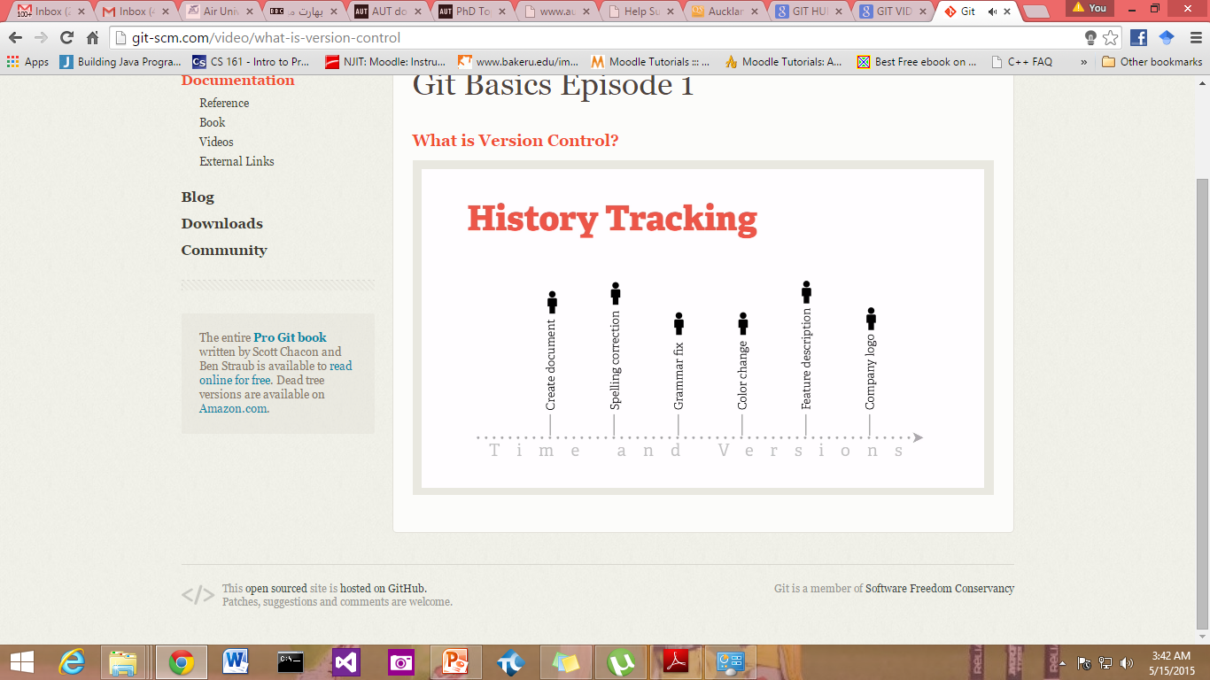
TRACKING CHANGES

Slide 6
Git Resources
At the command line: (where verb = config, add, commit, etc.)
$ git help <verb>
$ git <verb> --help
$ man git-<verb>
Free on-line book: http://git-scm.com/book
Git tutorial: http://schacon.github.com/git/gittutorial.html
Reference page for Git: http://gitref.org/index.html
Git website: http://git-scm.com/
Git for Computer Scientists (http://eagain.net/articles/git-for-computer-scientists/)

Slide 7
Git History
Came out of Linux development community
Linus Torvalds, 2005
Initial goals:
  Speed
  Support for non-linear development (thousands of parallel branches)
  Fully distributed
  Able to handle large projects like Linux efficiently
Notes:
Initial goals were to support development of Linux

Slide 8
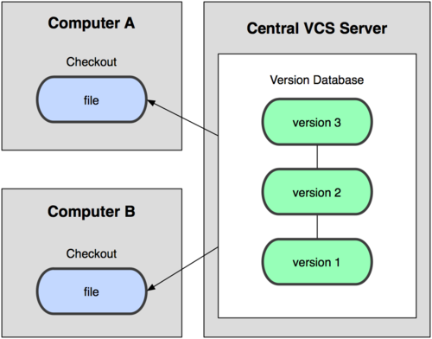
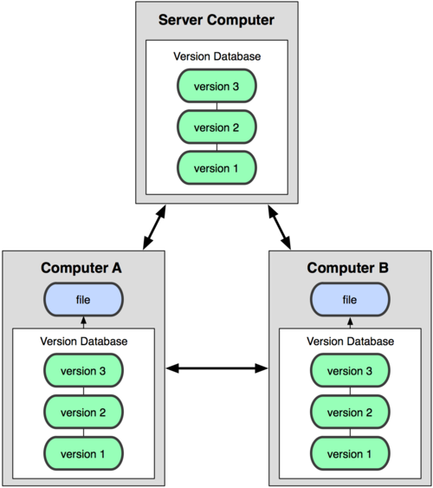
Git uses a distributed model
Centralized Model
Distributed Model
(CVS, Subversion, Perforce)
(Git, Mercurial)
Result: Many operations are local
Notes:
http://git-scm.com/book/en/Getting-Started-About-Version-Control

Slide 9
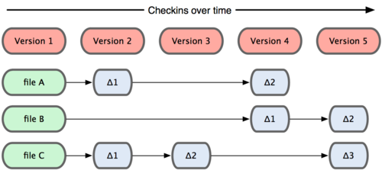
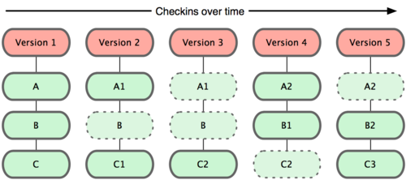
Git takes snapshots
Subversion
Git

Slide 10
Git uses checksums
In Subversion each modification to the central repo incremented
the version # of the overall repo.
How will this numbering scheme work when each user has their own copy of the repo, and commits changes to their local copy of the repo before pushing to the central server?????
Instead, Git generates a unique SHA-1 hash – 40 character string
of hex digits, for every commit. Refer to commits by this ID rather
than a version number. Often we only see the first 7 characters:
  1677b2d Edited first line of readme
  258efa7 Added line to readme
  0e52da7 Initial commit

Slide 11

A Local Git project has three areas
Unmodified/modified
Files
Staged
Files
Committed
Files
Note: working directory sometimes called the “working tree”, staging area sometimes called the “index”.

Slide 12
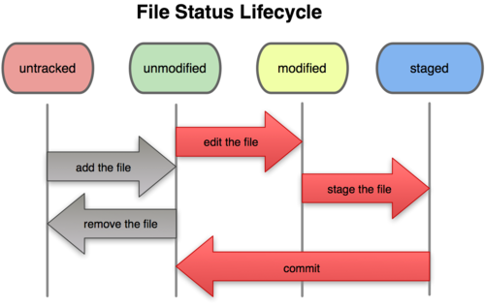
Git file lifecycle

Slide 13
Basic Workflow
Basic Git workflow:
Modify files in your working directory.
Stage files, adding snapshots of them to your staging area.
Do a commit, which takes the files as they are in the staging area and stores that snapshot permanently to your Git directory.
Notes:
  If a particular version of a file is in the git directory, it’s considered committed.
  If it’s modified but has been added to the staging area, it is staged.
  If it was changed since it was checked out but has not been staged, it is modified.

Slide 14
Aside: So what is github?
GitHub.com is a site for online storage of Git repositories.
Many open source projects use it, such as the Linux kernel.
You can get free space for open source projects or you can pay for private projects.
Question: Do I have to use github to use Git?
Answer: No!
you can use Git completely locally for your own purposes, or
you or someone else could set up a server to share files, or
you could share a repo with users on the same file system, such as we did for homework 9 (as long everyone has the needed file permissions).

Slide 15
Get ready to use Git!
Set the name and email for Git to use when you commit:
$ git config --global user.name “Bugs Bunny”
$ git config --global user.email bugs@gmail.com
You can call git config –list to verify these are set.
These will be set globally for all Git projects you work with.
You can also set variables on a project-only basis by not using the
--global flag.
You can also set the editor that is used for writing commit messages:
$ git config --global core.editor emacs (it is vim by default)

Slide 16
Create a local copy of a repo
Two common scenarios: (only do one of these)
  To clone an already existing repo to your current directory:
$ git clone <url> [local dir name]
This will create a directory named local dir name, containing a working copy of the files from the repo, and a .git directory (used to hold the staging area and your actual repo)
  To create a Git repo in your current directory:
    $ git init
    This will create a .git directory in your current directory.
    Then you can commit files in that directory into the repo:
    $ git add file1.java
    $ git commit –m “initial project version”

Slide 17
Git commands
command | description
git clone url [dir] | copy a git repository so you can add to it
git add files | adds file contents to the staging area
git commit | records a snapshot of the staging area
git status | view the status of your files in the working directory and staging area
git diff | shows diff of what is staged and what is modified but unstaged
git help [command] | get help info about a particular command
git pull | fetch from a remote repo and try to merge into the current branch
git push | push your new branches and data to a remote repository
others: init, reset, branch, checkout, merge, log, tag

Slide 18
Committing files
The first time we ask a file to be tracked, and every time before we commit a file we must add it to the staging area:
$ git add README.txt hello.java
This takes a snapshot of these files at this point in time and adds it to the staging area.
To move staged changes into the repo we commit:
$ git commit –m “Fixing bug #22”
  Note: To unstage a change on a file before you have committed it:
  $ git reset HEAD -- filename
  Note: To unmodify a modified file:
  $ git checkout -- filename
Note: These commands are just acting on your local version of repo.

Slide 19
Status and Diff
To view the status of your files in the working directory and staging area:
$ git status or
$ git status –s
(-s shows a short one line version similar to svn)
To see what is modified but unstaged:
$ git diff
To see staged changes:
$ git diff --cached

Slide 20
After editing a file…
[rea@attu1 superstar]$ emacs rea.txt
[rea@attu1 superstar]$ git status
# On branch master
# Changes not staged for commit:
# (use "git add <file>..." to update what will be committed)
# (use "git checkout -- <file>..." to discard changes in working directory)
#
# modified: rea.txt
#
no changes added to commit (use "git add" and/or "git commit -a")
[rea@attu1 superstar]$ git status -s
M rea.txt ← Note: M is in second column = “working tree”
[rea@attu1 superstar]$ git diff ← Shows modifications that have not been staged.
diff --git a/rea.txt b/rea.txt
index 66b293d..90b65fd 100644
--- a/rea.txt
+++ b/rea.txt
@@ -1,2 +1,4 @@
Here is rea's file.
+
+One new line added.
[rea@attu1 superstar]$ git diff --cached ← Shows nothing, no modifications have been staged yet.
[rea@attu1 superstar]$

Slide 21
After adding file to staging area…
[rea@attu1 superstar]$ git add rea.txt
[rea@attu1 superstar]$ git status
# On branch master
# Changes to be committed:
# (use "git reset HEAD <file>..." to unstage)
#
# modified: rea.txt
#
[rea@attu1 superstar]$ git status -s
M rea.txt ← Note: M is in first column = “staging area”
[rea@attu1 superstar]$ git diff ← Note: Shows nothing, no modifications that have not been staged.
[rea@attu1 superstar]$ git diff --cached ← Note: Shows staged modifications.
diff --git a/rea.txt b/rea.txt
index 66b293d..90b65fd 100644
--- a/rea.txt
+++ b/rea.txt
@@ -1,2 +1,4 @@
Here is rea's file.
+
+One new line added.

Slide 22
Viewing logs
To see a log of all changes in your local repo:
$ git log or
$ git log --oneline (to show a shorter version)
  1677b2d Edited first line of readme
  258efa7 Added line to readme
  0e52da7 Initial commit
git log -5 (to show only the 5 most recent updates, etc.)
Note: changes will be listed by commitID #, (SHA-1 hash)
Note: changes made to the remote repo before the last time you cloned/pulled from it will also be included here

Slide 23
Pulling and Pushing
Good practice:
Add and Commit your changes to your local repo
Pull from remote repo to get most recent changes (fix conflicts if necessary, add and commit them to your local repo)
Push your changes to the remote repo
To fetch the most recent updates from the remote repo into your local repo, and put them into your working directory:
$ git pull origin master
To push your changes from your local repo to the remote repo:
$ git push origin master
Notes: origin = an alias for the URL you cloned from
master = the remote branch you are pulling from/pushing to,
(the local branch you are pulling to/pushing from is your current branch)
Note: On attu you will get a Gtk-warning, you can ignore this.
Notes:
$ git remote -v
origin https://github.com/rea2000/santalist.git (fetch)
origin https://github.com/rea2000/santalist.git (push)

Slide 24
Branching
To create a branch called experimental:
$ git branch experimental
To list all branches: (* shows which one you are currently on)
$ git branch
To switch to the experimental branch:
$ git checkout experimental
Later on, changes between the two branches differ, to merge changes from experimental into the master:
$ git checkout master
$ git merge experimental
Note: git log --graph can be useful for showing branches.
Note: These branches are in your local repo!

Slide 25
SVN vs. Git
SVN:
  central repository approach – the main repository is the only “true” source, only the main repository has the complete file history
  Users check out local copies of the current version
Git:
  Distributed repository approach – every checkout of the repository is a full fledged repository, complete with history
  Greater redundancy and speed
  Branching and merging repositories is more heavily used as a result

Slide 26
Do This:
$ git config --global user.name “Your Name”
$ git config --global user.email youremail@whatever.com
$ git clone https://github.com/rea2000/santalist.git
Then try:
$ git log, $ git log --oneline
Create a file named userID.txt (e.g. rea.txt)
$ git status, $ git status –s
Add the file: $ git add userID.txt
$ git status, $ git status –s
Commit the file to your local repo:
$ git commit –m “added rea.txt file”
$ git status, $ git status –s, $ git log --oneline
*WAIT, DO NOT GO ON TO THE NEXT STEPS UNTIL YOU ARE TOLD TO!!
Pull from remote repo: $git pull origin master
Push to remote repo: $git push origin master

Slide 27
GIT COMES WITH PRACTICE
Start your new project lets say web project
Idintify different features of this project
List functionalities
Do some coding and design and commit on git for windows using git commands
Try the commands that we did in 2 lectures
Make your work flow
See the tree
Check comparisons
Push your working repository on GIT HUB

Slide 28
So want to GIT?
THIS WILL NEED AN ACCOUNT
ONCE PUSHED IDENTIFY ISSUES AND CHANGE REQUESTS
DO SOME COMMITS
INIVITE OTHERS TO WORK ON YOUR WEB PROJECT REPOSITORY
ONCE SOME CHANGES DONE PULL BACK ON GIT WINDOWS CLIENT
COMPARE CHANGES ..
KEEP REPEATING THIS CYCLE UNTILL THIS PROCESS IS COMPLETED.
GIT BOOK (BRIEF) AND CHEATSHEET AVAILABLE ON SERVER

Slide 29
References
HTTP://WWW.GITHUB.COM MAIN SOURCE)
DOWNLOAD GITHUB
https://windows.github.com/

